Slide 1
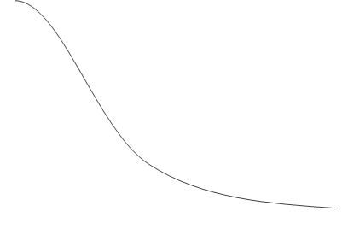





$$99.5\%$$
$$α=0.0025$$
$$α=0.0025$$
$$t=−8.021$$
$$t=−3.091$$
$$t=−3.091$$

